Slide 1


Front-End Development Lesson 2
Sapsan-Code

Slide 2
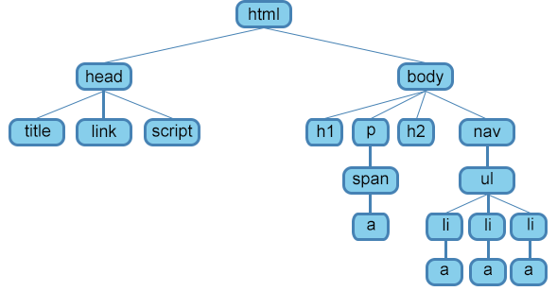

Slide 3
На заметку
<meta http-equiv="X-UA-Compatible" content="IE=edge">
<meta name="viewport" content="width=device-width, initial-scale=1.0">
<img /> в <p></p>
<i> vs <em>
<strong> vs <b>
<q> vs <blockquote>
Отступы тегом <p></p>

Slide 4
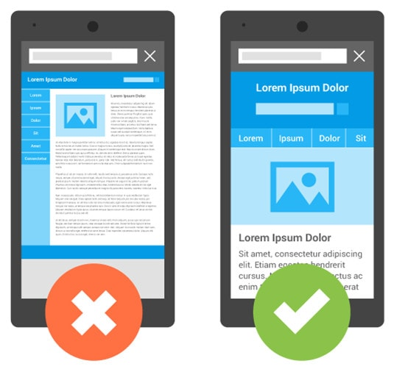

Slide 5
Продвинутые HTML теги
<img>
<ol>
<ul>
<li>
<select>
<option>
<input>
<label>

Slide 6
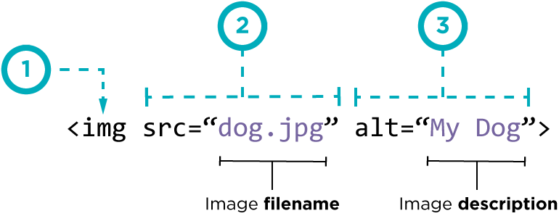
Тэг <img>

Slide 7
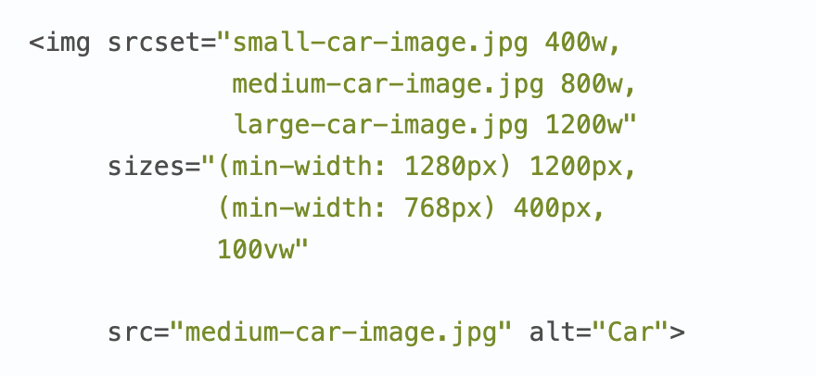
Тэг <img>

Slide 8
Листы
<!DOCTYPE html>
<html lang="en">
<head>
<meta charset="UTF-8">
<meta http-equiv="X-UA-Compatible" content="IE=edge">
<meta name="viewport" content="width=device-width, initial-scale=1.0">
<title>Document</title>
</head>
<body>
<ul>
<li>This is element of my unordered List</li>
<li>This is element of my unordered List</li>
<li>This is element of my unordered List</li>
<li>This is element of my unordered List</li>
</ul>
<ol>
<li>This is element of my Ordered List</li>
<li>This is element of my Ordered List</li>
<li>This is element of my Ordered List</li>
<li>This is element of my Ordered List</li>
<li>This is element of my Ordered List</li>
</ol>
</body>
</html>

Slide 9
Селекты
<!DOCTYPE html>
<html lang="en">
<head>
<meta charset="UTF-8">
<meta http-equiv="X-UA-Compatible" content="IE=edge">
<meta name="viewport" content="width=device-width, initial-scale=1.0">
<title>Document</title>
</head>
<body>
<h1>Select Your Dream school</h1>
<select name="my_select">
<option value="Sapsan">Sapsan Is the Best!</option>
<option value="Sapsan">There is no better school than Sapsan</option>
<option value="Sapsan">Come on man, are you serious right now?</option>
<option value="Sapsan">There is no other schools!</option>
</select>
</body>
</html>

Slide 10
Селекты
<!DOCTYPE html>
<html lang="en">
<head>
<meta charset="UTF-8">
<meta http-equiv="X-UA-Compatible" content="IE=edge">
<meta name="viewport" content="width=device-width, initial-scale=1.0">
<title>Document</title>
</head>
<body>
<h1>Select Your Dream school</h1>
<select name="my_select">
<option value="Sapsan">Sapsan Is the Best!</option>
<option value="Sapsan">There is no better school than Sapsan</option>
<option value="Sapsan">Come on man, are you serious right now?</option>
<option value="Sapsan">There is no other schools!</option>
</select>
</body>
</html>

Slide 11
Input и Label
<!DOCTYPE html>
<html lang="en">
<head>
<meta charset="UTF-8">
<meta http-equiv="X-UA-Compatible" content="IE=edge">
<meta name="viewport" content="width=device-width, initial-scale=1.0">
<title>Document</title>
</head>
<body>
<label for="peas">What is your name?</label>
<input type="text" name="peas" id="peas">
<label for="peas">Do you like Sapsan-Code?</label>
<input type="checkbox" name="peas" id="peas">
</body>
</html>

Slide 12
Задание
Вам нужно создать свое онлайн резюме, где будет:
Ваша фотография
Информация о ваших навыках
Информация о вашем хобби
Опросник по поводу вашего CV
Вы должны сами изучить тэг button и интегрировать его в ваш проект.

